Slide 1
Fermentation Technology
HIMAKSHI BAISHYA
assistant professor, b.voc, fpt
MANGALDAI COLLEGE

Slide 2
Contents.
Unit 1
History of fermentation, introduction to fermentation process, media formulation and process optimization
Unit 2
Microorganisms used in food fermentation, types of culture, starter culture –maintenance, propagation and cultivation of culture.
Unit 3
Types of fermentation-submerged/solid state fermentation, batch/ continuous fermentation, fermenter design and operation.
Unit 4
Fermented foods – types, methods of manufacture for sauerkraut, tempeh, miso,
soya sauce and traditional Indian foods

Slide 3
HISTORY OF FERMENTATION
Fermentation started taking place before recorded history.
Nomads discovered that milk would change to solid cheese or semi-solid yoghurt under certain conditions.
For centuries people have made alcoholic beverages by using yeast to ferment fruit juices.
The chemistry of fermentation were first investigated by Louis Pasteur in 1850. Through a series of experiments, Louis Pasteur, a French microbiologist, showed that wine fermentation is caused by a type of fungi known as yeasts
In 1851 Pasteur found that wine was spoiling and he realized that some bacteria in the wine were fermenting and also spoiling the wine and then he came up with the idea of Pasteurization.
In 1856, an accident at a sugar beetroot distillery led to a ground breaking discovery that was pivotal to subsequent production of cheese and yogurt. Pasteur was tasked to investigate the issue and found that instead of alcohol, the “spoiled” beetroot mixture contained mostly lactic acid, which caused a sour taste. The sour beetroot mixture also contained many objects smaller than yeasts. These objects were later confirmed to be lactic acid bacteria. This serendipitous incident was instrumental to our modern day understanding that fungi and bacteria perform fermentation differently.

Slide 4
Fermentation Time Line
Cheese production in Iraq: 7000 BCE
Wine making in the Near East: 6000 BCE
Yeasts' properties are discovered in Egypt & used in leavened bread & wine making: 4000 BCE
Fermented milk products became part of the human diet in many regions: 2000-12000 BCE
Barley is fermented & turned into beer in Sumer: 1750 BCE
Meat sausages were beginning to be prepared in Babylon: 1500 BCE
Chinese regions began to use moldy soybean curd as an antibiotic: 500 BCE
Vegetable preservation by fermentation is used in China: 300 BCE
Cereal-legume based foods are developed: 500-1000 CE
First whiskey distillery founded in Ireland: 1276 CE
Sauerkraut & yoghurt begin to be fermented: 1500 CE
Pasteurization developed by Louis Pasteur: 1851 CE
Defined cultures are used in fermentation processes: 1900-1930 CE
Robiotic cultures & bacteria used in mainstream foods 1970- present

Slide 5
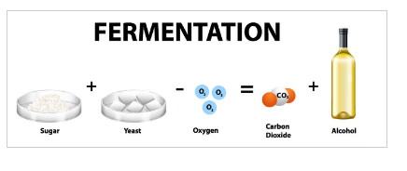
INTRODUCTION
Fermentation is a metabolic process in which an organism converts a carbohydrate, such as starch or a sugar, into an alcohol or an acid. For example, yeast performs fermentation to obtain energy by converting sugar into alcohol. Bacteria perform fermentation, converting carbohydrates into lactic acid.
Fermentation is a process that helps break down large organic molecules via the action of microorganisms into simpler ones.
C₆H₁₂O₆ → 2 C₂H₅OH + 2 CO₂

Slide 6
The word fermentation comes from the Latin word “fervere” which means “to boil.” The boiling appearance is due to the production of carbon dioxide bubbles caused by the anaerobic catabolism of the sugars present in the extracts.
The study of fermentation is called zymology.
In practice fermentation is an art, it encourages the growth of right microorganisms and discourages the growth of spoilage microorganisms.
Factors affecting fermentation
pH
Composition of the medium
Nature of medium
Temperature
Dissolved carbon dioxide, oxygen

Slide 7
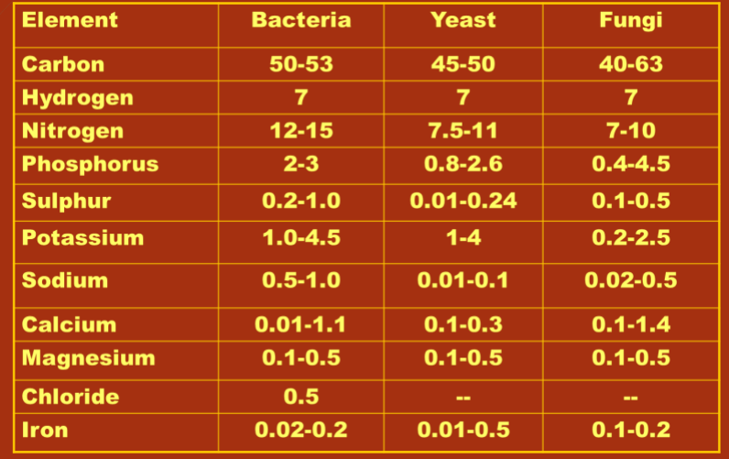
MEDIA FORMULATION
Media formulation is essential stage in manufacturing process.
Carbon + Nitrogen + Oxygen + Other requirements -------› Biomass + Product + Carbon dioxide + Water + Heat.
Medium should offer the necessary amounts of carbon, nitrogen, micronutrients such as vitamins and trace elements

Slide 8
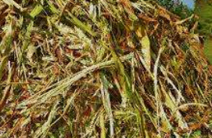
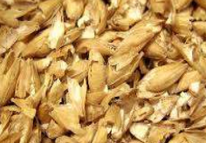
COMPONENTS OF MEDIA
Fermentation medium consists of macronutrients, micronutrients, trace elements, dissolved oxygen, vitamins, enzymes, other dissolved gases, and inhibitors.
Water: Chief constituent of every fermentation medium is water and it is required in rinsing, cooling, and heating. Mineral contents of water historically influence the types of beer produced.
Carbon Source: Carbon is considered as a main product of a fermentation process. A carbon source is required for all biosynthesis leading to reproduction, product formation and cell maintenance. In most fermentations it also serves as the energy source.
Carbon Source
Fig: Molasses
Fig: Malted Barley

Slide 9
Nitrogen Sources: Industrially used microorganisms have ability to use organic as well as inorganic means of nitrogen. Inorganic source of nitrogen is supplied as ammonium salts, ammonia gas and nitrates. Inorganic substrates which can be used as a source of nitrogen includes urea, ammonium salts, and ammonia.
Minerals: Essential minerals which are used in all media formulation include potassium, sulphur, chlorine, phosphorous, magnesium, and calcium We require a minute amounts other minerals such as cobalt, manganese, zinc, iron, copper and molybdenum and they exist as impurities. The specific concentration of these all elements depends on the micro-organism.
Energy Sources: Light or medium components of oxidation are main source of energy which is required for growth. As industrial microbes are chemo-organotrophs, so their source of energy is carbon source in form of lipids, proteins, and carbohydrates. While, in some cases, methanol or hydrocarbons may be used by some microorganisms as a source of energy or carbon

Slide 10
Chelators: Many media cannot be prepared without precipitation during autoclaving. Hence some chelating agents are added to form complexes with metal ions which are gradually utilised by microorganism. Examples of chelators: EDTA, citric acid, polyphosphates etc., It is important to check the concentration of chelators otherwise it may inhibit the growth. In many media these are added separately after autoclaving Or yeast extract, peptone complex with these metal ions. In large scale fermentation chelating agents are not necessary.
Vitamins and Growth Factors: Many bacteria can synthesize all necessary vitamins from basic elements. For other bacteria, filamentous fungi and yeasts, they must be added as supplements to the fermentation medium. Few of the microbes cannot produce complete complement of components of the cell and consequently requisite some of the preformed components known as growth factors. Growth factors includes amino acids, vitamins, sterols and fatty acids. Some natural sources such as nitrogen and carbon are used in growth medium formulations having required growth factors

Slide 11
Buffers: pH has great influence on microbial growth. pH of the growth media can be maintained by addition of buffers that would resist pH changes. Many microorganisms have optimum pH range 7.0. Some of the examples of buffers that are commonly used include; ammonia sodium hydroxide and calcium carbonate.
ADDITION OF METABOLIC REGULATORS
Precursors: Many precursor molecules are used as metabolic regulators that improves product yield. Some of the chemicals are used as precursors and induced to cultivation processes that incorporate into the product formed by fermentation process. Eg: Propionate as precursor is used in riboflavin production and the microorganism used is Lactobacillus bulgaricus.
Inducers: Inducible enzymes are of interest in industry. Inducers are substrates which include pectin for pectinases, maltose for pullulanase, and starch or dextrin for amylases.

Slide 12
Inhibitors: are used to redirect metabolism towards the target product and reduce formation of other metabolic intermediates. An example of an inhibitor specifically employed to redirect metabolism is sodium bisulphite which represses the production of acetaldehyde. Glycerol, which is produced due to the microorganisms. Glycerol production is possible after modification of ethanol by removing acetaldehyde. Acetaldehyde is formed as sodium bisulfite is added to broth.
Oxygen: Availability of oxygen is of huge importance in controlling the production of metabolites and growth rate of microbes. The medium can affect availability of oxygen in variety of ways. Depending on the amount of oxygen required by the organism, it may be supplied in the form of air containing about 21% (v/v) oxygen or occasionally as pure oxygen when requirements are particularly high.
Antifoams: are necessary to reduce foam formation during fermentation. It act as surface active agents and lower down the transfer rate of oxygen.

Slide 13
CHARACTERISTICS OF MEDIA
It should produce maximum product.
It should give minimum yield of undesired product.
It should be cheap.
It should cause minimal problems in aeration, medium formation, sterilization, agitation, extraction, purification and waste treatment.
It should produce maximum concentration of biomass and must be available throughout the year.
Media must satisfy all nutritional requirements of the organism and fulfil the objectives of the process

Slide 14
PROCESS OPTIMIZATION
Medium optimization is a process where components of medium or different conditions either varied in concentration or changed so that we can get better growth of the organisms for high productivity.
There are many challenges associated with optimization of fermentation process, it is laborious, expensive, open ended and time consuming process involving many experiments. In bioprocess industry it is often needs to conduct optimization experiments because new mutants and strains are continuously being introduced. It is carried out in order to enhance the productivity of the metabolites.
During the medium designing and optimization, there are various strategies available which are frequently used to improve the efficiency of the production medium.

Slide 15
The quantity and quality of nutrients available and the ability to assimilate successfully are the major determinants of microbial nature and its metabolic activity. Hence, during the medium optimization it must be considered that a minimal growth requirement of the microorganism must be fulfilled for obtaining maximum production of metabolite(s). As the fermentation process progresses into lower-value, higher-volume chemicals, it becomes necessary to maximize the efficiency and minimize the production cost and waste by-products to compete effectively against the traditional methods.

Slide 16
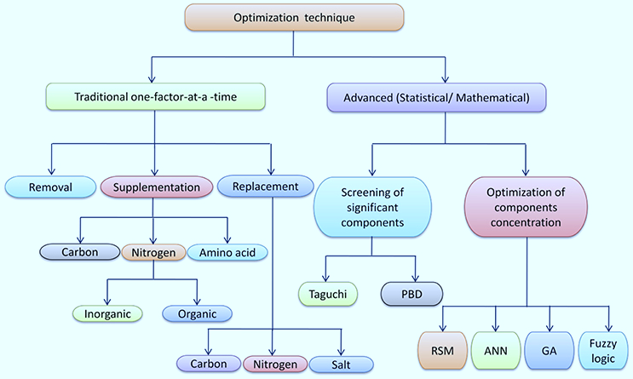

Slide 17
UNIT-2
Microorganisms used in food fermentation, types of culture, starter culture –maintenance, propagation and cultivation of culture.

Slide 18
MICROORGANISMS USED IN FOOD FERMENTATION
ROLE OF MICROORGANISM IN FOOD FERMENTATION
Microorganisms transform the chemical constituents of raw materials of plant/animal sources during food fermentation thereby enhancing the bio-availability of nutrients, enriching sensory quality of the food, imparting bio-preservative effects and improvement of food safety, degrading toxic components and anti-nutritive factors, producing antioxidant and antimicrobial compounds, stimulating the probiotic functions, and fortifying with some health-promoting bioactive compounds

Slide 19
Among bacteria associated with fermented foods and alcoholic beverages, lactic acid bacteria (LAB) mostly species of Enterococcus, Lactobacillus, Lactococcus, Leuconostoc, Pediococcus, Weissella, etc. are widely present in many fermented foods and beverages.
Species of Bacillus are also present in legume-based fermented foods.
Species of Bifidobacterium, Brachybacterium, Brevibacterium, and Propionibacterium are isolated from cheese, and species of Arthrobacter and Hafnia from fermented meat products.
Several genera with hundred of species of yeasts have been isolated from fermented foods, alcoholic beverages and non-food mixed amylolytic starters which mostly include Candida, Debaryomyces, Geotrichum, Hansenula, Kluyveromyces, Pichia, Rhodotorula, Saccharomyces, Saccharomycopsis, Schizosaccharomyces, Torulopsis, Wickerhamomyces, and Zygosaccharomyces

Slide 20
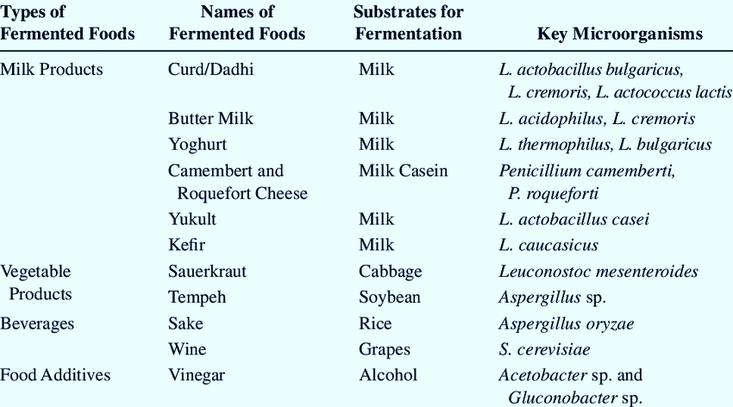

Slide 21
CULTURE MEDIA
A culture media is a special medium used to grow different kinds of microorganisms. A growth or a culture medium is composed of various nutrients that are essential for microbial growth.
A culture may be solid or liquid.
Microorganisms have varying nature, characteristics, habitat, and even nutritional requirements, thus it is impossible to culture them with one type of culture media. However, there are also microorganisms that can’t grow on a culture media at all in any condition – these are called obligate parasites. Since there are many types of microorganisms, each having unique properties and requiring specific nutrients for growth, there are many types of culture mediums based on what nutrients they contain and what function they play in the growth of microorganisms.

Slide 22
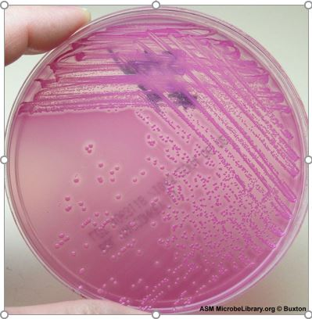
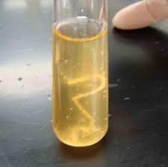
TYPES OF CULTURE
Classification of culture media based on consistency
Solid Media: In these media, the is added in the concentration of 1.5-2.0%. Most commonly, 1.3% agar is used to prepare solid media. It melts at high temperatures, and yet is solid at temperatures used for most bacterial growth. Solid growth media is used in the following forms: agar plates, agar slants, and agar deeps.
Liquid Media: These media do not contain any traces of solidifying agents, such as agar or gelatin, and large growth of bacterial colonies can be observed in the media. Liquid media are also called broths, they allow for uniform and turbid growth of bacterial strains when incubated at 37ºC for 24hrs.
Semi solid media: This media has 0.2-0.5% agar concentration, and due to the reduced agar concentration, it appears as a soft, jelly-like substance. It’s mainly used to study the motility of microorganisms, distinguish between motile and non-motile bacterial strains etc.
Agar
Broth

Slide 23
Classification based on the nutritional component
Simple media: It’s a general-purpose media that supports the growth of non-fastidious microbes, and it is primarily used for the isolation of microorganisms. Examples are nutrient broth, peptone water, and nutrient agar.
Complex media: These are media containing nutrients in unknown quantities that are added to bring about a particular characteristic of a microbial strain. Examples are tryptic soy broth, blood agar, and nutrient broth.
Synthetic media: Synthetic media is a type of chemically defined media and is produced from pure chemical substances. A defined media refers to a medium having a known concentration of ingredients, like sugar (glucose or glycerol) and nitrogen source (such as ammonium salt or nitrate as inorganic nitrogen). It is generally used in scientific research, and an example is Czapek Dox Medium.

Slide 24
Classification of culture media based on application/chemical composition
Basal media: These are routinely used simple media having carbon and nitrogen sources that boost the growth of many microorganisms. They are also known as general-purpose media and are considered non-selective media. Examples are nutrient broth, nutrient agar, and peptone water.
Enriched media: This media is prepared by adding additional substances like blood, serum, or egg yolk in the basal medium. It’s used to grow fastidious microorganisms as they require additional nutrients and growth-promoting substances. Examples are chocolate agar, blood agar, and Loeffler’s serum slope.
Selective media: This media allows the growth of certain microbes while inhibiting the growth of others. It’s an agar-based medium. The selective growth of microbes is decided by adding substances like antibiotics, dyes, bile salts, or by pH adjustments. Examples are MacConkey’s Agar, Mannitol Salt Agar.

Slide 25
Enrichment media: It’s a liquid medium, used to increase the relative concentration of certain microbes before culturing them on a solid medium plate. Examples are selenite F broth, tetrathionate broth, and alkaline peptone water.
Differential or indicator media: It contains certain indicators like dyes or metabolic substrates in the medium composition which gives different colors to colonies of different microbial species when they utilize or react with these components.
Transport media: Transport media are useful for clinical specimens which are required to be transferred immediately to labs to maintain the viability of potential pathogens and to prevent overgrowth of commensals or contaminating microorganisms.
Anaerobic media: This media is for anaerobic bacteria which require low oxygen levels, extra nutrients, and reduced oxidation-reduction potential.

Slide 26
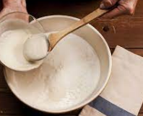
STARTER CULTURE
A starter culture is a microbial culture which actually performs fermentation.
Starter preparations assist the beginning of the fermentation process in preparation of various foods and fermented drinks. A number of bacterial and other microbial strains have been used either in single or in combination for producing the desired effect in the finished product.
Starter culture for dahi preparation

Slide 27
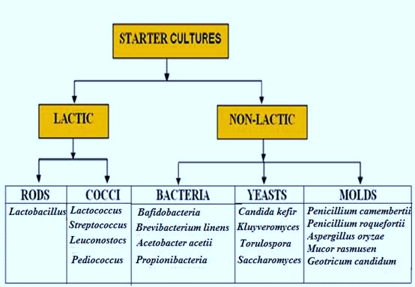

Slide 28
PROPAGATION
Starter Propagation Is the most important operation of the quality control unit of the processing as the quality of starter is having a direct bearing on the quality of finished product. The main aim of propagation is to maintain pure cultures and activate cultures without any loss of viability . The culture organisms are preserved in small quantities known as ‘stock cultures’.
An active starter must have the following characteristics
1. Must be active
2. Must contain maximum number of viable organisms
3. Must be free from contaminants
To obtain active qualities of culture
1. The inoculum (Inoculation) is carried out under aseptic conditions
2. Growth is initiated in a sterile medium

Slide 29
Traditional Method of starter culture propagation
In this method the starter are propagated in the laboratory itself taking the stock cultures which are in in-active state or dormant state. Commercial manufacturers provide starter cultures in lyophilized (freeze-dried), frozen or spray-dried forms. These cultures cannot be added directly in the product to initiate fermentation process because they are in an in-active state. They need to be brought in to active form and also scale up to prepare bulk quantities.
Stock culture: can be obtained from Research establishments, Educational colleges, Cultural stock Organizations, Commercial manufacturers
WDCM - The World Directory of collection of cultures of microorganisms.
NCDC - National Collection of dairy Culture- NDRI ,Karnal.
ATCC -American Type Culture CollectionECCO - European Culture Collections Organization
NCFB - National Collection of Food Bacteria-UK
NCIM - National Collection of Industrial Microorganisms- Pune
NIZO - Netherlands Dairy Research Institute

Slide 30
Commercial Method for propagation of starter culture
1. Preparation of Mother Culture
The preparation of mother culture is a very important step in the production of bulk starters The mother cultures are generally maintained in narrow neck polyethylene bottles, which are thoroughly cleaned and sterilized using steam jets. Sometimes these bottles are sanitized with 0.1 per cent -hypochlorite solution. The milk is pasteurized in these bottles at 72-73 ͦC for 45 minutes and the bottles then submerged in the cooling water, and thereafter, these milk bottles are stored in a refrigerator for future use. The milk containing bottle is inoculated by injecting few drops of the desired culture by means of a hypodermic needle, which can pierce the seals of caps. Thereafter, the content is incubated at desired temperature in a BOD incubator.

Slide 31
Preparation of Bulk Starters
The vessels of different sizes are used for preparation of bulk starters. These vessels are closed completely air tight after the initial stage of filling with milk. These cans are filled with milk and heat treated by steam at 72-73 ͦC for 45 min and cooled to incubation temperatures. The bulk culture is inoculated and incubated in the same manner as the mother cultures.
Preparation of Master Culture
In case of preparation of master culture, the method of inoculation is the same as for mother culture.

Slide 32
MAINTENANCE OF STARTER CULTURE:
It is essential that starter cultures are preserved in order to maintain an available stock of these microorganisms for the production of bulk starter.
In general, starter cultures may be preserved by one of the following methods:
Liquid starters: Starter cultures can be preserved in a liquid form using one of two different growth media.
Dried starters: One method for the preservation of starter cultures is drying. The different drying methods used are: Vacuum drying (old methods not used at present time), Spray drying, Freeze drying or lyophilization (widely used in the laboratory), Freeze drying of concentrated cultures (widely used commercially).
Frozen starters: Starter cultures can also be preserved in the frozen form and such cultures are produced by two different routes:
Deep or subzero freezing (-30 to –80 degree Celsius).
Ultra low temperature freezing (-196 degree Celsius) in liquid nitrogen.

Slide 33
UNIT-3
Types of fermentation- submerged/solid state fermentation, batch/ continuous fermentation, fermenter design and operation.

Slide 34
Types of Fermentation
1. On the number of products formed :
Homo fermentation: only one type of product formation
Hetero fermentation: more than one product formed
2. On the basis of end product produced:
Lactic Acid Fermentation: The type of fermentation where lactic acid is formed from pyruvate produced in glycolysis. Eg: Lactobacillus bacteria prepare curd from milk via this type of fermentation.

Slide 35
Alcohol Fermentation: The type of fermentation where end product produced is alcohol is called alcoholic fermentation. This is used in the industrial production of wine, beer, biofuel, etc.
The end product is alcohol and CO2. Pyruvic acid breaks down into acetaldehyde and CO2 is released. In the next step, ethanol is formed from acetaldehyde. NAD+ is also formed from NADH, utilized in glycolysis. Yeast and some bacteria carry out this type of fermentation.

Slide 36

Acetic acid Fermentation: This is a two-step process. The first step is the formation of ethyl alcohol from sugar anaerobically using yeast. In the second step, ethyl alcohol is further oxidized to form acetic acid using acetobacter bacteria. Microbial oxidation of alcohol to acid is an aerobic process. Vinegar is produced by this process
Butyric acid Fermentation: This type of fermentation is characteristic of obligate anaerobic bacteria of genus clostridium. This occurs in retting of jute fibre, rancid butter, tobacco processing and tanning of leather. Butyric acid is produced in the human colon as a product of dietary fibre fermentation.

Slide 37
3. On the basis of fermentation system
Submerged state fermentation (SmF): involves inoculation of the microbial culture into the liquid medium for production of the desired product.
Most of the commercial products are produced through the SmF processes
Fungal species such as Aspergillus niger, A. terreus, A. tamarii, Fusarium, and Penicillium are used for this type of fermentation.
SmF utilizes free flowing liquid substrates, such as molasses and broths.
An additional advantage of this technique is thatpurification of products is easier. SmF is primarily used inthe extraction of secondary metabolites that need to be used in liquid form.

Slide 38
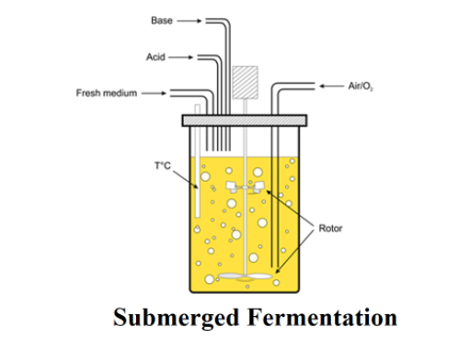

Slide 39
Solid State Fermentation (SSF)
Solid state fermentation is a manufacturing process used in the production of fuel, food, pharmaceutical and industrial products.
It is used as an alternative to submerged fermentation. It is known in Japan as Koji fermentation and has existed for many years.
It is the use of microorganisms in a controlled environment to produce enzymes, fuel and nutrients. Solid state fermentation occurs in the absence of free water.
It is a much more simple process which requires a lot less energy. It produces a much higher volumetric productivity and it is similar to the natural environment of certain fungi.

Slide 40
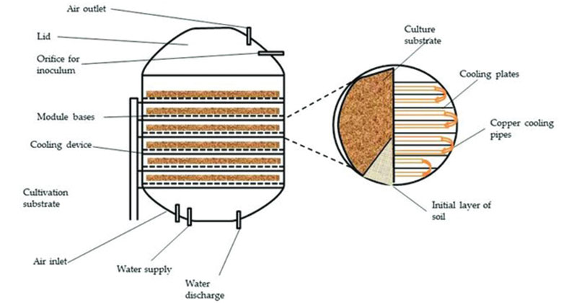

Slide 41
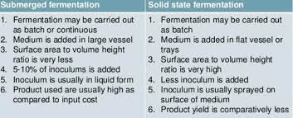

Slide 42
Batch fermentation: is a process where all the substrate and nutrients are added at zero time or soon after inoculation takes place, and the vessel is allowed under a controlled environment to proceed until maximum end product concentration is achieved.
Continuous fermentation: Continuous fermentation is an open operation system with continuous addition and discharge of the solution in the system. Microorganisms and sterile nutrient solution are added homogeneously to the bioreactor, continuously, while nutrient solution and microorganisms are transformed equivalently in the system.

Slide 43
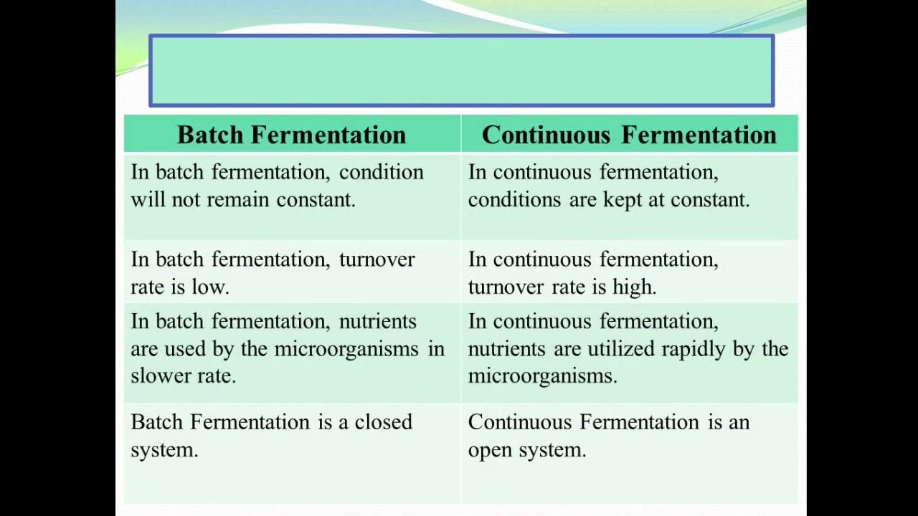
BATCH AND CONTINUOUS FERMENTATION

Slide 44
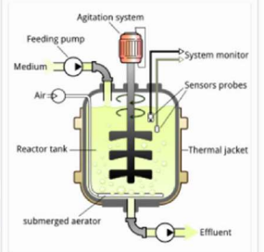
FERMENTER DESIGN AND OPERATION

Slide 45
FERMENTED FOODS
Traditional fermented food is not only the staple food for most of developing countries but also the key healthy food for developed countries.
As the healthy function of these foods are gradually discovered, more and more high throughput biotechnologies are being used to promote the old and new industry.
The application and progress of the high throughput biotechnologies into traditional fermented food industries like fermented milk products (yogurt, cheese), fermented sausages, fermented vegetables (kimchi, sauerkraut), fermented cereals (sourdough) and fermented beans (tempeh, natto) are gaining momentum.

